Slide 1
Cainan Black Senior Project
Java Calculator Application

Slide 2
New and Improved working Environment
Will be using Eclipse for all programing
Swing will be used to build all gui
Swing is a Java Foundation Class [JFC] and an extension of the Abstract Window Toolkit [AWT].
Written fully in Java and built into the Java Library

Slide 3
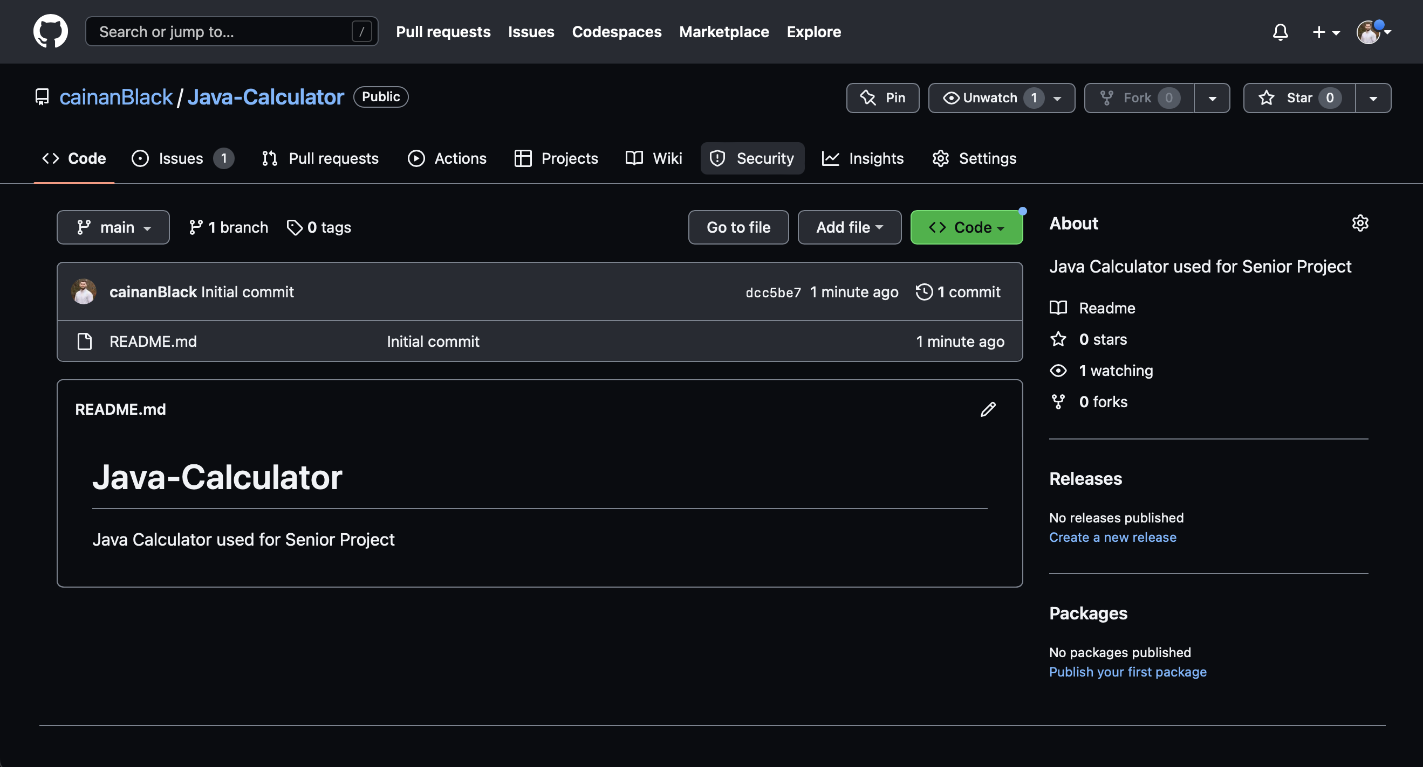
Git Repo

Slide 4
Mock image

Slide 5
Workflow
Class of constructors for the buttons and windows and visuals using Swing
Class of main code that controls all execution of code.
Functions that receive input and perform operations to output the desired result.

Slide 6
Work for next week
Develop specific steps to take to begin building the application
Write out weekly goals
Have presentable code (probable a small amount)

